Slide 1
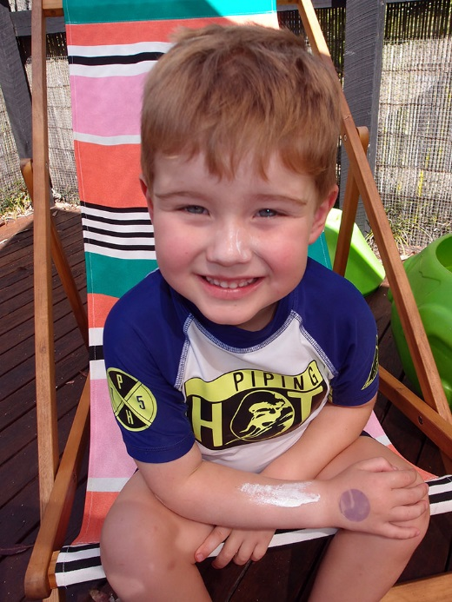

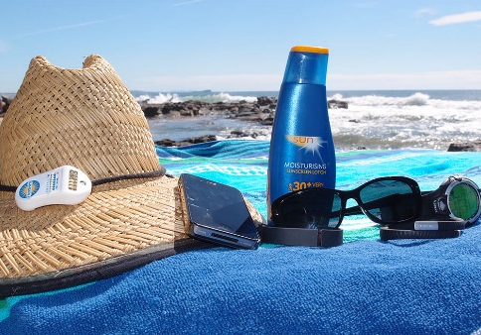
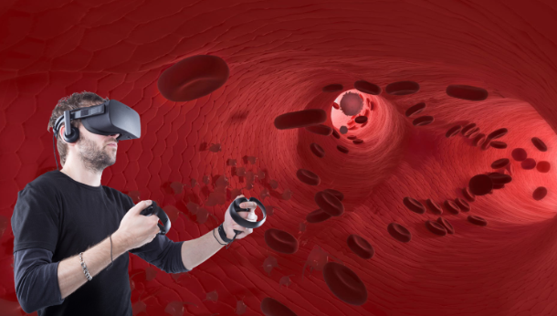
A virtual reality game for cancer prevention: Malignancy VR
Dr Elke Hacker

Slide 2
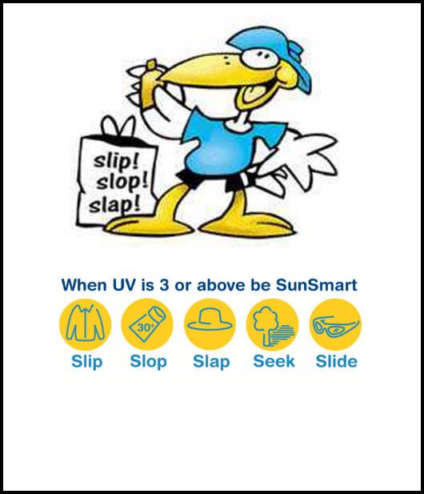
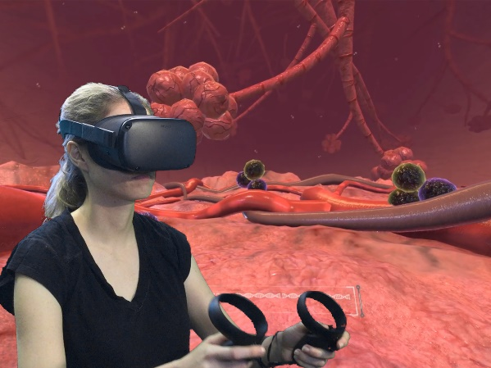
Can a virtual reality experience improve sun protection behaviours
Background:
Public health sun safety campaigns successfully
In Queensland in 2020 young adults were at least four times more likely to report sunburn than older adults
New Strategies required
Objective: The aim of this study was to develop a virtual reality (VR) game containing preventative skin cancer messaging, and to assess safety and satisfaction on the design based on end-user feedback.
Notes:
Public health sun safety campaigns introduced during the 1980’s have successfully reduced skin cancer rates in Australia.
Despite this success, high rates of sunburn continue to be reported by youth and young adults.
As such, new strategies to reinforce sun protection approaches in this demographic are needed.
CHO report shows
In Queensland in 2020 young adults (18–29 year-olds) were at least four times more likely to report sunburn than older adults (65 years and older)

Slide 3
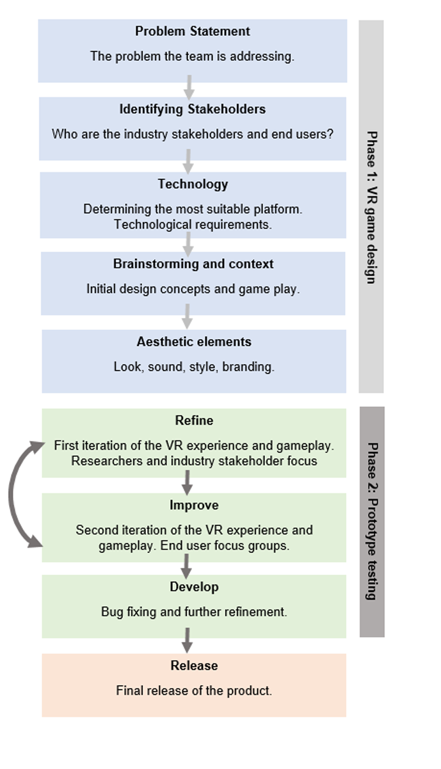
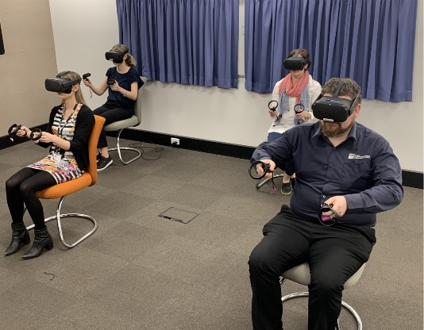
Methods
Methods: Using a two-phase design approach, we created a prototype VR game that immersed the player inside the human body while being confronted with growing cancer cells.
End users in focus groups
Notes:
The first design phase involved defining the problem, identifying stakeholders, choosing the technology platform, brainstorming and designing aesthetic elements.
In the second design phase, we tested the prototype VR experience with stakeholders and end users in focus groups with feedback incorporated into refining and improving the design.

Slide 4
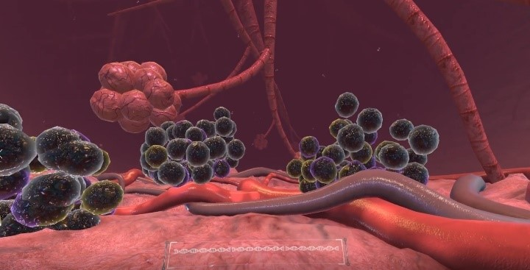
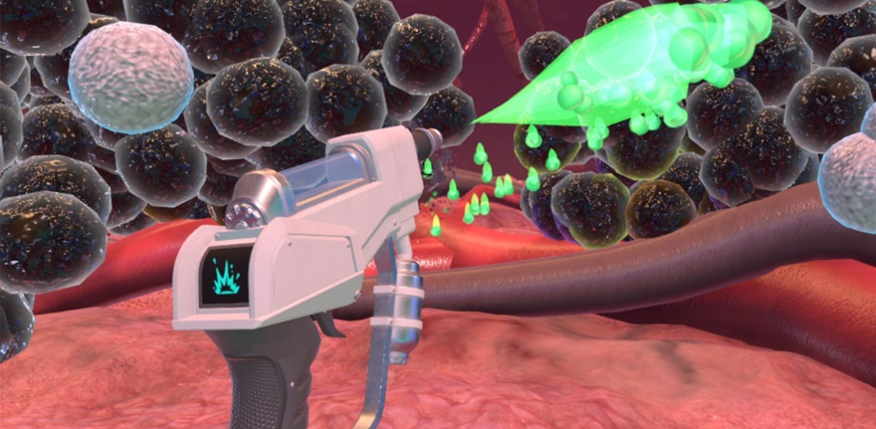
Results
High levels of satisfaction
Two participants (11.1%) reported a side effect of feeling nauseous during the experience.
Improvements included extending the experience and more interactions involving cancer causation.
Play Video of the Game Experience
Notes:
The implementation of the VR game identified challenges around sharing VR equipment and hygiene issues.
Qualitative feedback indicated high levels of satisfaction with all participants (n=18) reporting the VR game as ‘engaging’.
Regarding safety, two participants (11.1%) reported a side effect of feeling nauseous during the experience.
The end user focus groups identified game improvements, suggesting an extended multi-stage experience with visual transitions to other environments and interactions involving cancer causation.

Slide 5
Conclusion
VR is an engaging platform
User centred design approach
Emerging field of research and sharing knowledge assists future programs
Notes:
VR is an engaging platform for health information to be consumed.
This two-stage user centred design approach could be applied to other health programs in the future. Enhancing our understanding of user centred design
This is an emerging field of research and the knowledge generated from the implementation of this project has built our capacity.

