Slide 1



Digital systems
Student activity guide

Slide 2
Systems

Slide 3
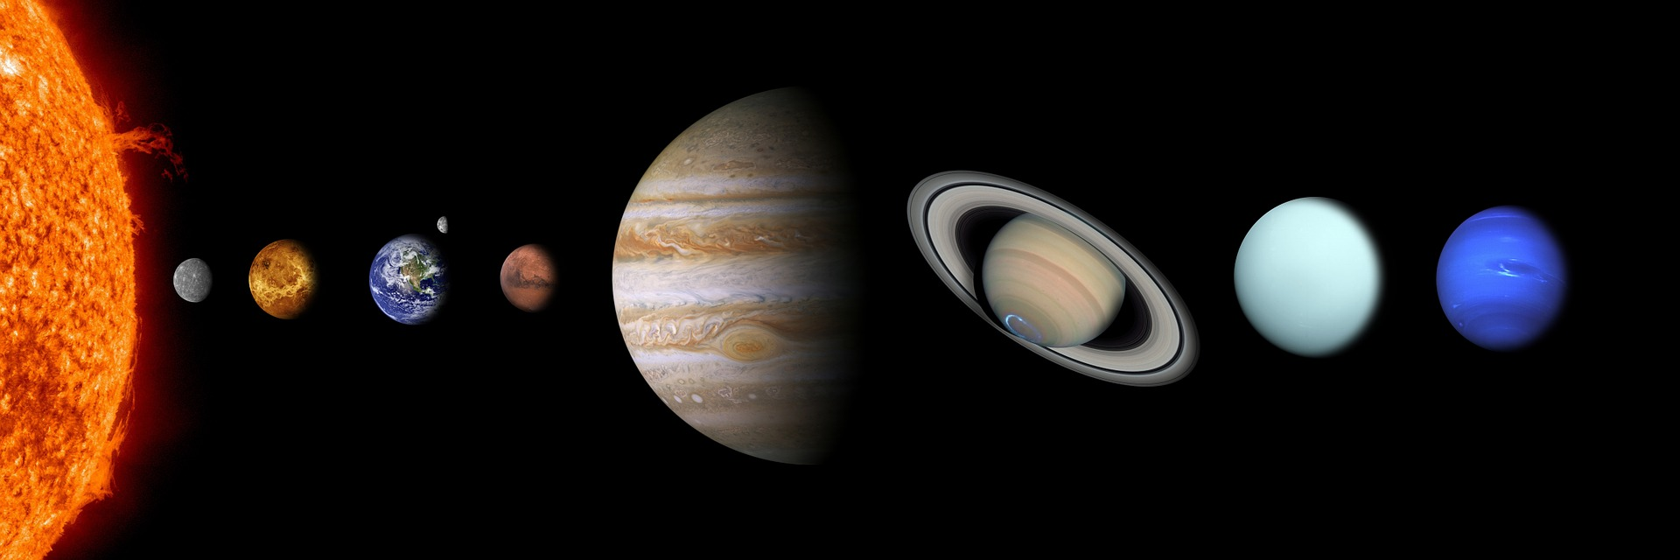
What is a system?
You would be familiar with the solar system.
Image source: https://pixabay.com/photos/solar-system-sun-mercury-venus-439046/

Slide 4
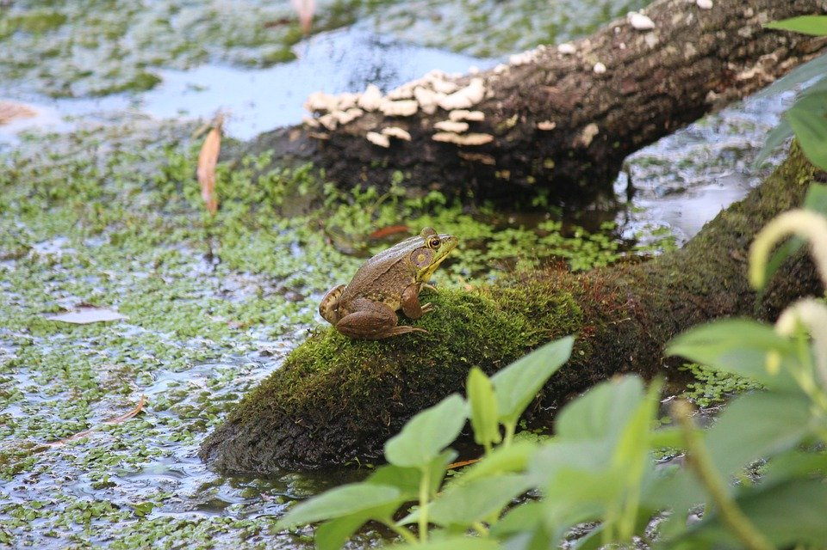
What is a system?
You’ve probably heard about ecosystems too.
Image source: https://pixabay.com/photos/frog-swamp-bullfrog-amphibian-5380422/

Slide 5

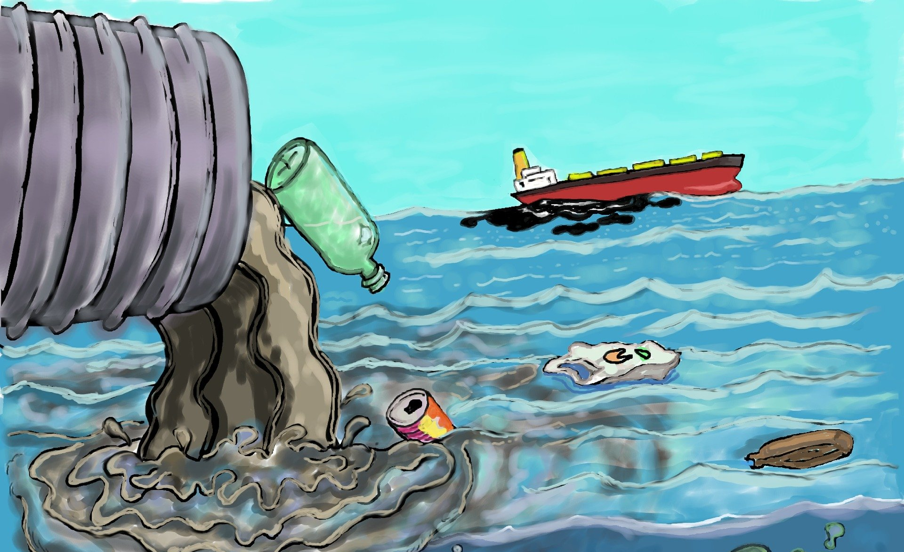
Systems thinking
Systems thinking helps us understand how the individual parts are interrelated. We can look at the impact on the whole system when something changes.
Systems thinking involves looking at a whole system and analysing how the components work together and affect the other parts.
Image source: https://pixabay.com/illustrations/pollution-trash-degradation-1603644/
Image source: https://pixabay.com/vectors/gears-work-team-together-5193383/
Notes:
Systems thinking helps us to identify all the parts of a system and how they are interrelated. It helps us to understand the impact on the whole system if something changes.

Slide 6
Digital systems

Slide 7
What is a digital system?
A digital system is a combination of hardware, software, data and processes.
Input
(putting data* into a computer)
Processing
(sorting, and carrying out instructions with data*)
Output
(the way data* are shared with the user)
*Data can be text, images, video or sound.

Slide 8

A computer is a digital system.
Output
(screen)
Processing
(CPU inside)
Output
(sound via speakers plugged into this port)
Input
(keyboard)
Input
(mouse)
Image source: pixabay.com/vectors/computer-desktop-workstation-office-158675/

Slide 9
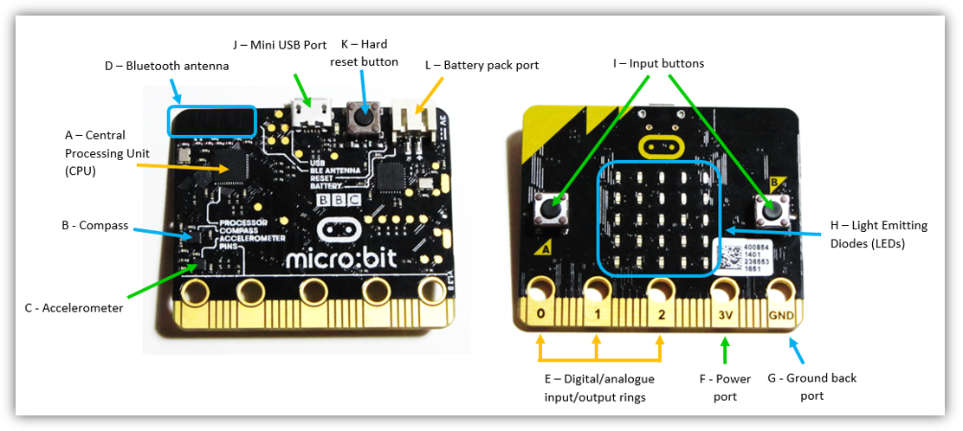
A micro:bit is a digital system.
Processing
(computer chip)
Input
(buttons)
Output (LED display)
Input
(sensors attached to rings)
Output
Image used with permission

Slide 10
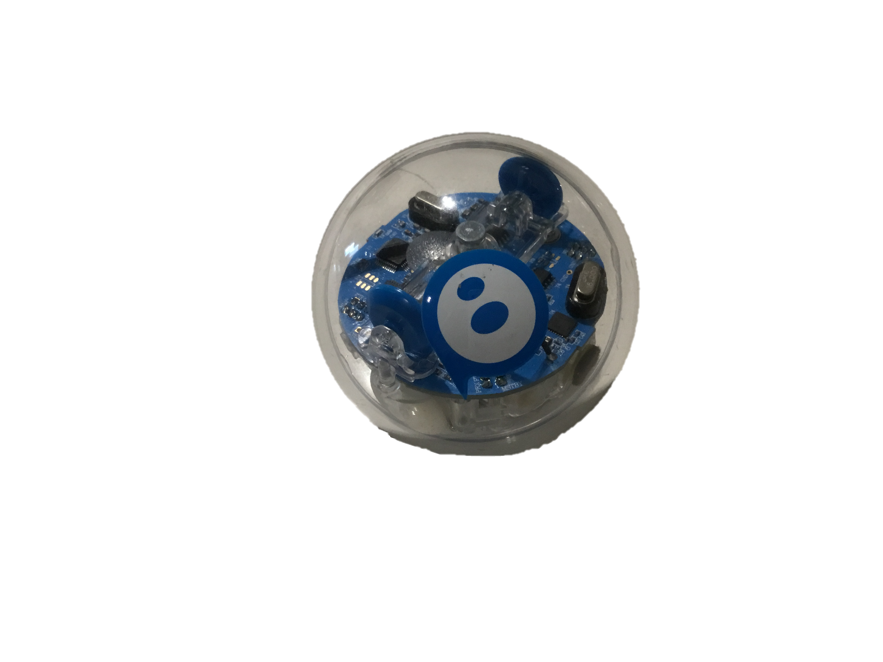
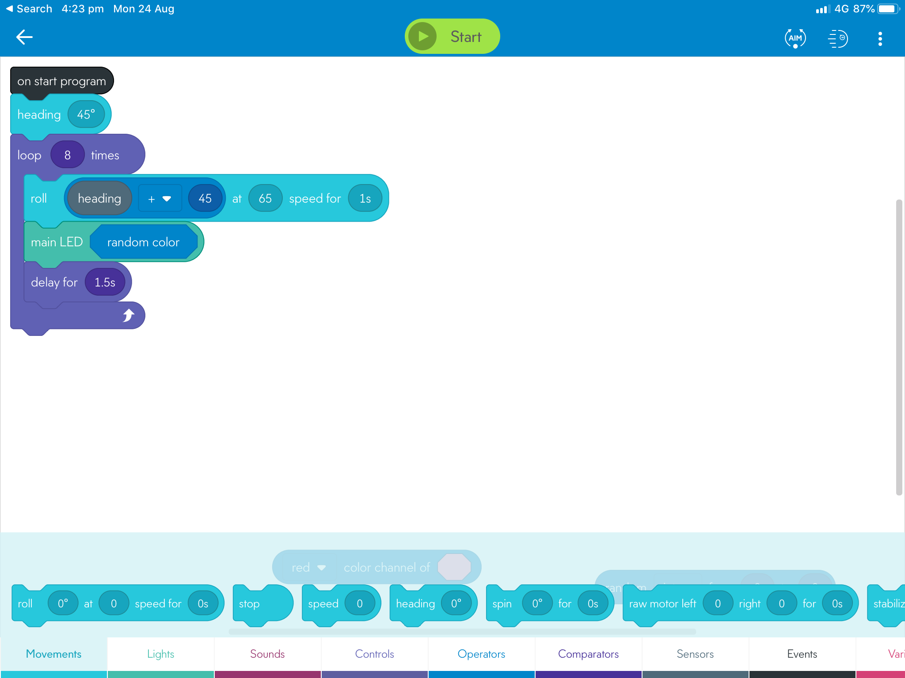
A Sphero is a digital system.
Processing
(computer chip)
Input
(device)
Output
Input
(sensors)
Image used with permission
Notes:
Re copyright do we have permission to show tablet and Sphero even with your image on the tablet screen? Both are branded products?
We may need the ACARA disclaimer from classroom ideas that says …
Disclaimer: ACARA does not endorse any product or make any representations as to the quality of such products. This resource is indicative only. Any product that uses material published on the ACARA website should not be taken to be affiliated with ACARA or have the sponsorship or approval of ACARA. It is up to each person to make their own assessment of the product, taking into account matters including the degree to which the materials align with the content descriptions and achievement standards of the Australian Curriculum. The Creative Commons licence BY 4.0 does not apply to any trademark-protected material.

Slide 11
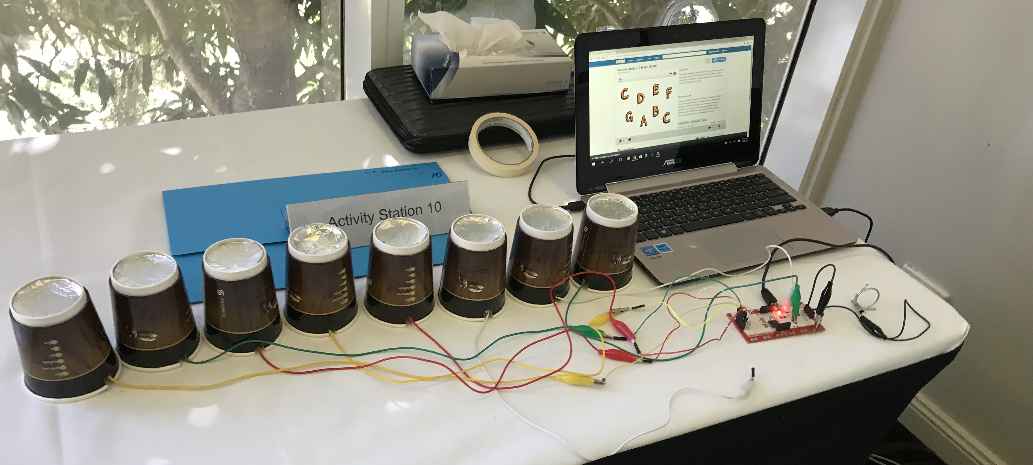
A Makey Makey and computer
is a digital system.
Output (sound)
Processing
(computer chip)
Input
(foil + wires)
Input
(wires attached to device + device attached to computer)
Image used with permission

Slide 12
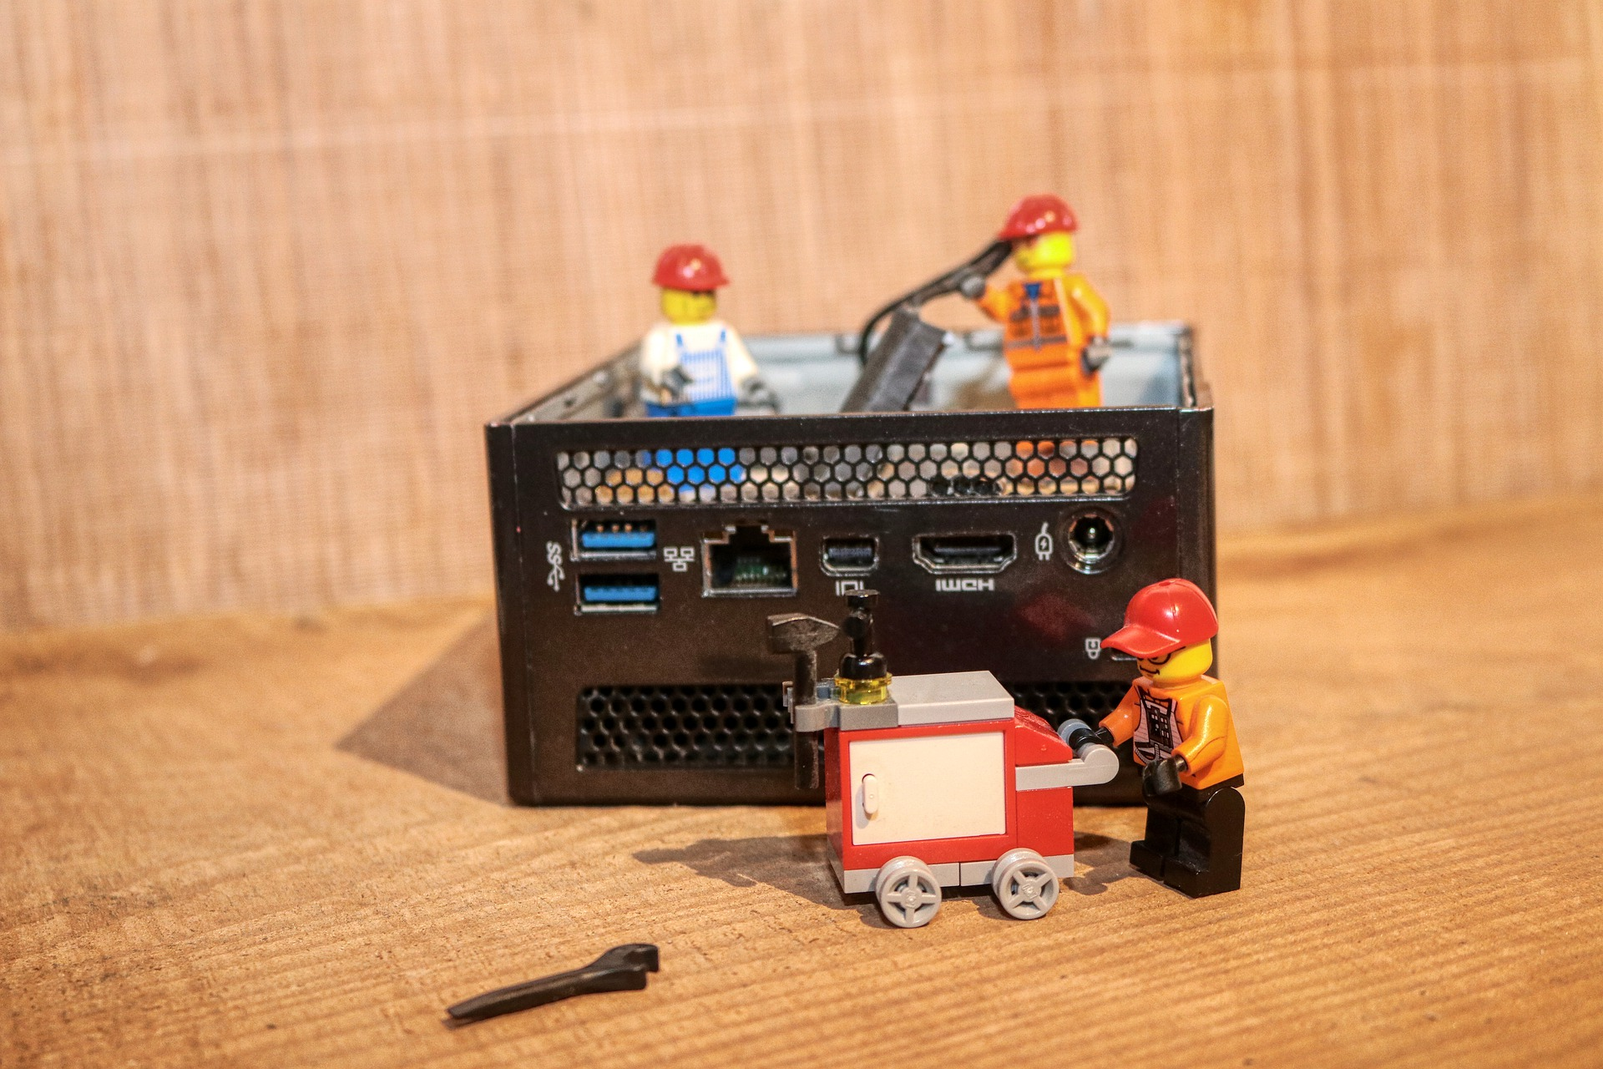
What happens if part of a digital system stops working?
Image source: https://pixabay.com/photos/repair-defect-broken-stop-5011207/
Notes:
Teacher note: This is intended as an activity for formative assessment purposes. This could be done as a whole group, small group, paired or individual activity. Encourage students to present ideas about hardware and software failures and how to troubleshoot. If one part of the system fails, then the whole system stops working. Students could share stories of situations they’ve had. For example: I had to restart the computer because the screen froze; I typed in the address of a website and it showed a message ‘404 not found’; I started typing and realised the keyboard wasn’t plugged in; my computer wouldn’t connect to the wi-fi/printer/camera; my phone screen got broken; a new phone cannot be used to make telephone calls without a SIM card.

Slide 13

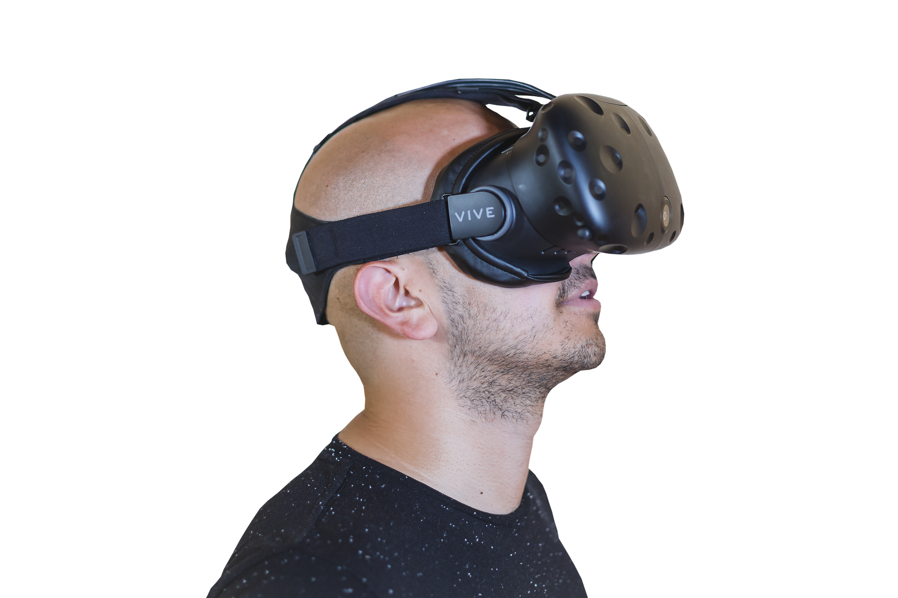
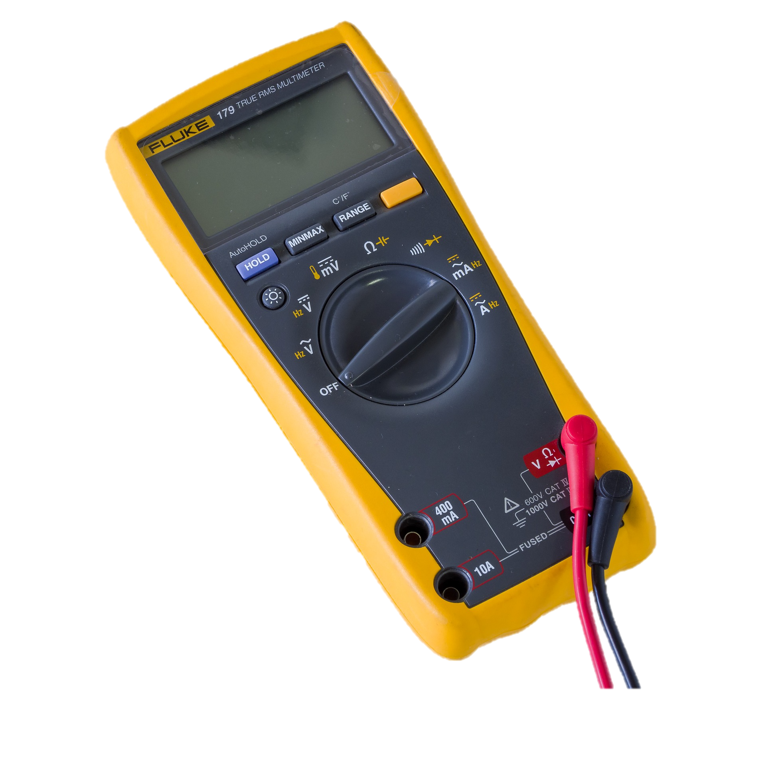


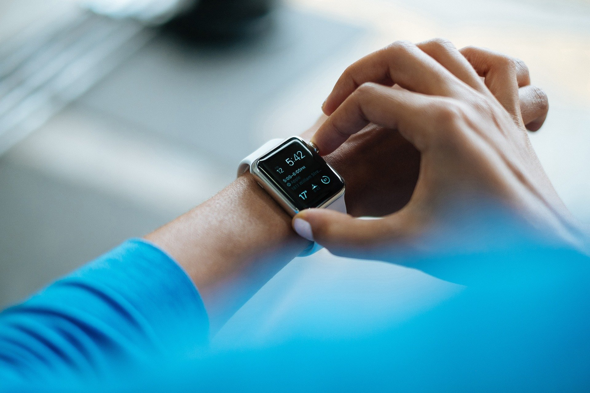
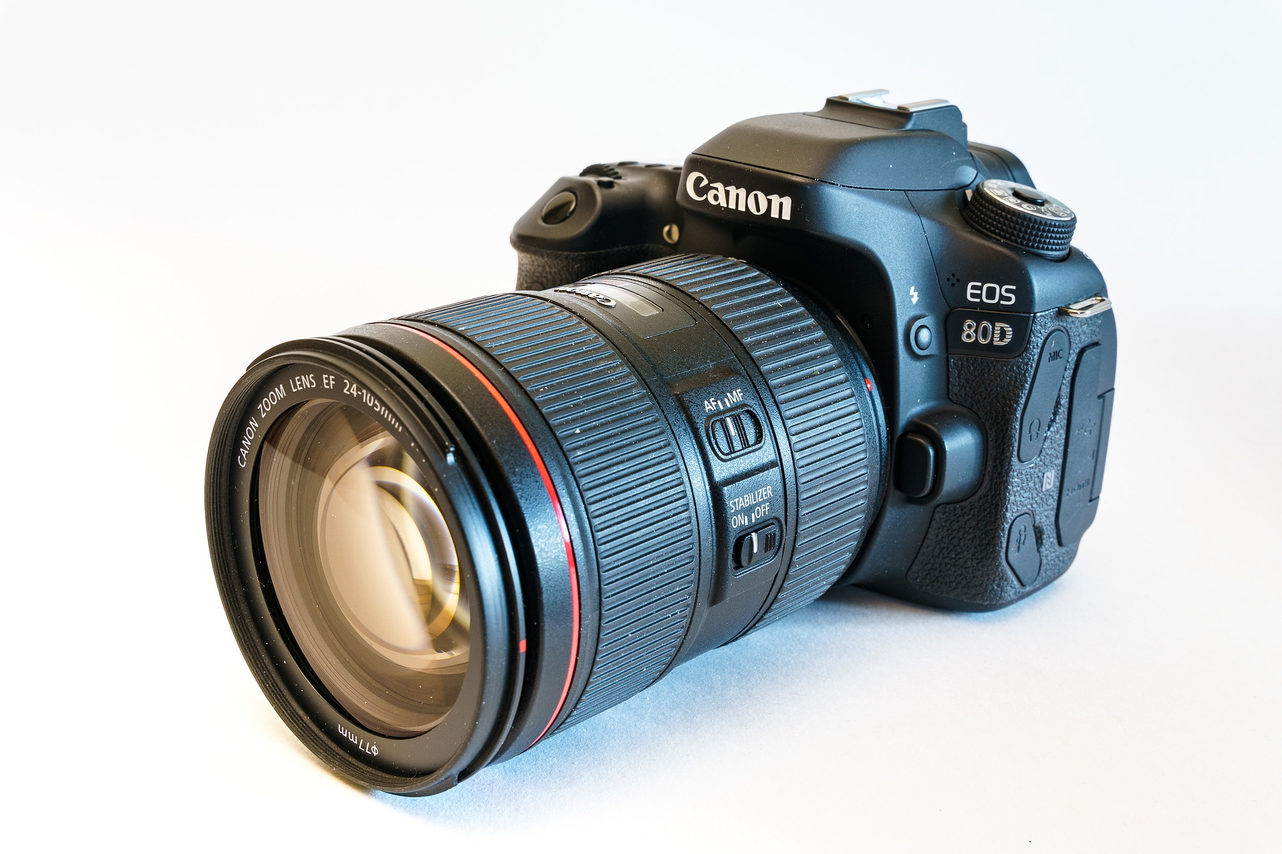
Can you name these digital systems?
1
Image source: https://pixabay.com/photos/camera-digital-camera-lens-canon-4840105/
Image source: https://pixabay.com/photos/people-man-guy-mustache-2557494/
Image source: https://pixabay.com/vectors/smartphone-android-os-samsung-153650/
Image source: https://pixabay.com/photos/smartwatch-gadget-technology-smart-828786/
Image source: pixabay.com/photos/fluke-179-true-rms-multimeter-4623180/
Image source: https://pixabay.com/photos/workstation-pc-mac-apple-inc-405747/
Notes:
Teacher note: This is intended as an activity for formative assessment purposes. This could be done as a whole group, small group, paired or individual activity. It can be verbal, recorded as a video or audio file or written in the portfolio booklet.
Image source:
Smart phone: pixabay.com/vectors/smartphone-android-os-samsung-153650/
VR: pixabay.com/photos/people-man-guy-mustache-2557494/
Multimeter: pixabay.com/photos/fluke-179-true-rms-multimeter-4623180/
Workstation: pixabay.com/photos/workstation-pc-mac-apple-inc-405747/
Smart watch: https://pixabay.com/photos/smartwatch-gadget-technology-smart-828786/
camera: pixabay.com/photos/camera-digital-camera-lens-canon-4840105/

Slide 14
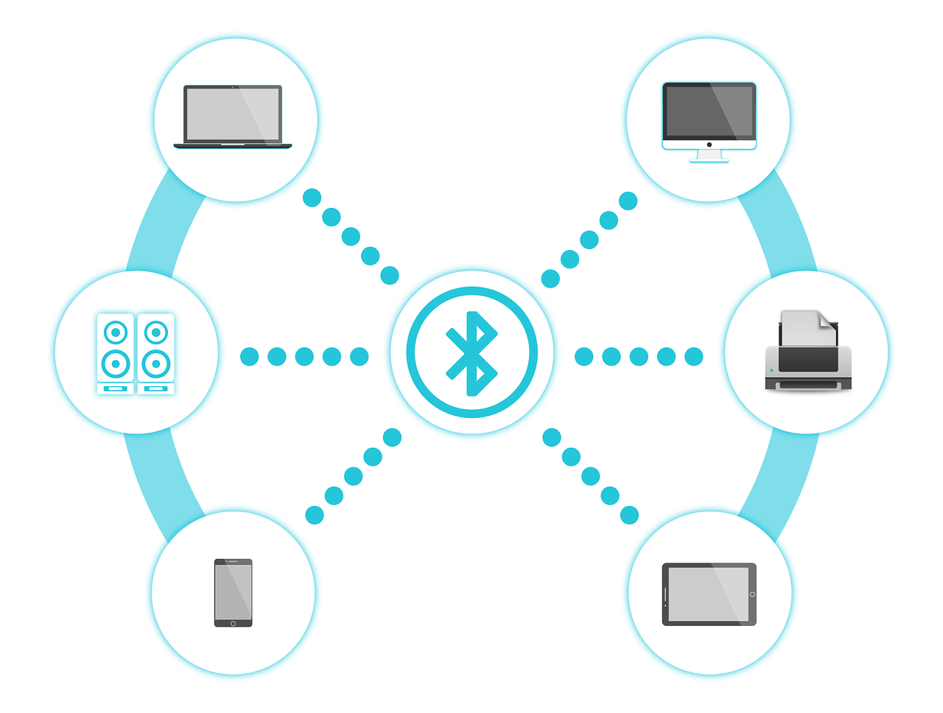
Most digital systems can connect to other digital systems.
Image source: https://pixabay.com/vectors/bluetooth-connectivity-wireless-1690677/
These devices use bluetooth to connect over a short distance.
Notes:
Teacher note: Bluetooth devices only work in a limited space over short distances.

Slide 15
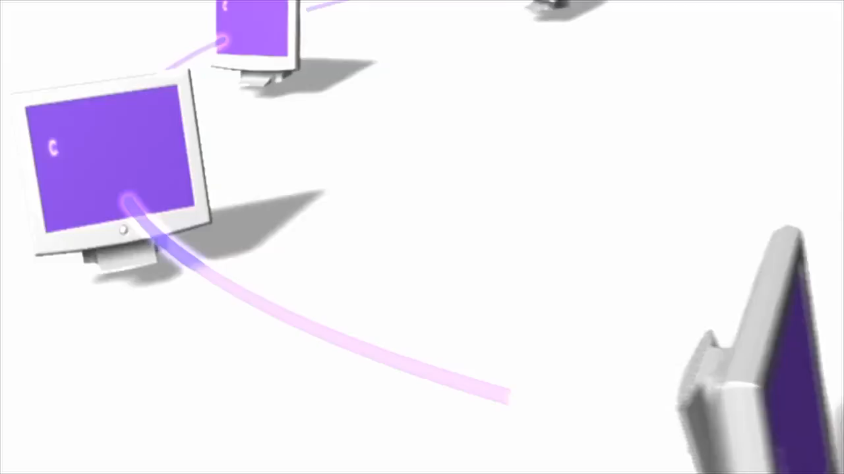
Digital systems can also connect over longer distances.
Video source: https://pixabay.com/videos/internet-connection-network-5347/
Notes:
Teacher note: Wi-fi, ethernet cables and satellites connect devices over longer distances. There are limits to wi-fi range and sometimes boosters are needed to boost the signal. Discuss with students how they might connect computers and other devices to the internet at home. If they don’t have home devices, discuss how the devices are connected in the school. You could consider a visit to the server room to look at the set-up.

Slide 16
Networks

Slide 17
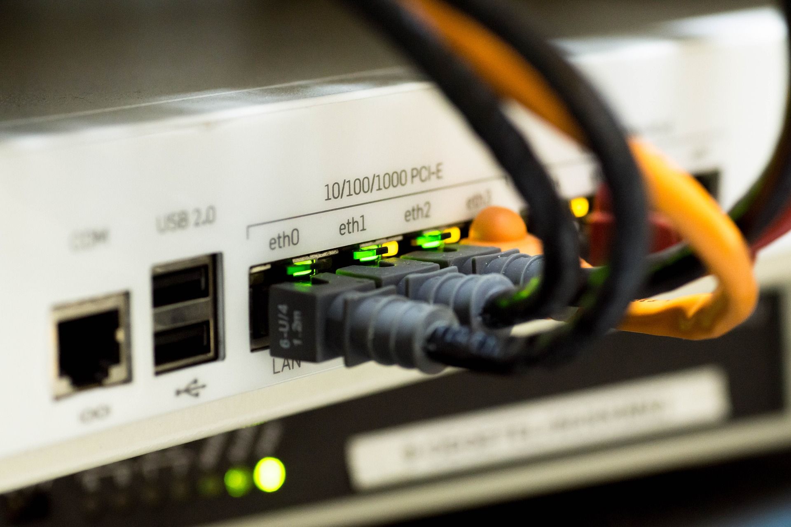

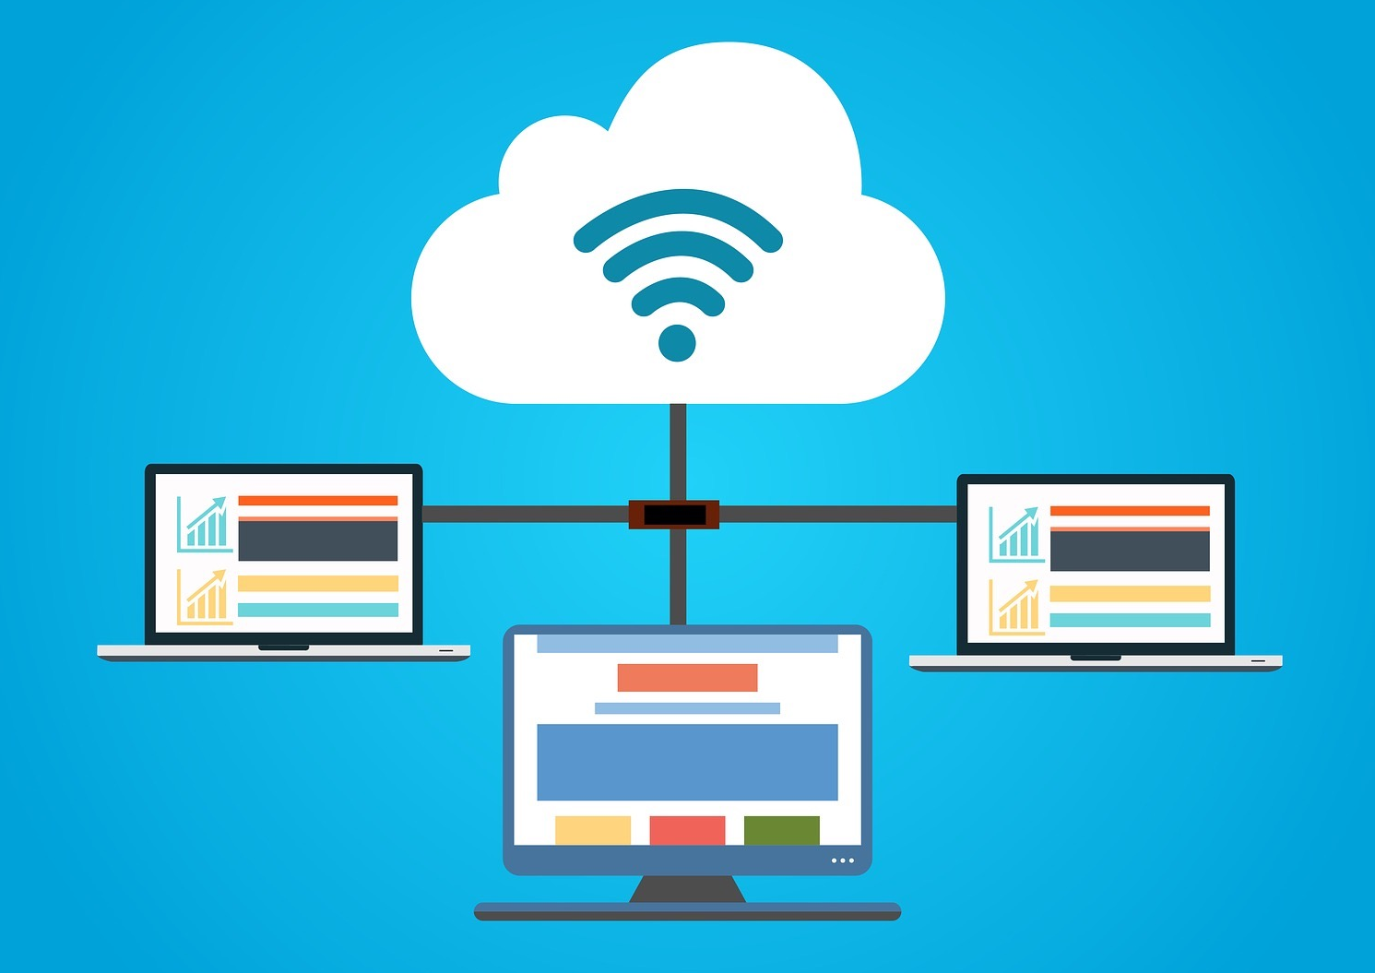
What is a network?
Networks can connect together with wires or be wireless (wi-fi).
Networked digital systems can share applications such as word processing, spreadsheet and presentation software.
Networked digital systems can share hardware like laptops, desktop computers, tablet devices, phones, printers and televisions.
A network is a number of digital systems linked together to allow them to communicate with each other and share files and other devices like printers.
Networked digital systems can share data like text, numbers, music, videos, animations and sounds including voice.
Image source: https://pixabay.com/photos/network-cable-ethernet-computer-1572617/
Image source: https://pixabay.com/vectors/wi-fi-wifi-symbol-wireless-2119225/
Image source: https://pixabay.com/illustrations/cloud-computer-hosting-3406627/
Notes:
Image source:
router: pixabay.com/photos/network-cable-ethernet-computer-1572617/
network: pixabay.com/illustrations/cloud-computer-hosting-3406627/
Wifi symbol: pixabay.com/vectors/wi-fi-wifi-symbol-wireless-2119225/

Slide 18

What are some examples of networks?
School file server
Shared printers on home computers
Photocopying and photo printing services
Information systems
The internet
Image source: https://pixabay.com/illustrations/binary-one-cyborg-cybernetics-1536651/

Slide 19



Can you name some networked digital systems?
2
Image source: https://pixabay.com/illustrations/purple-dress-girl-notebook-bubble-4135356/ and https://pixabay.com/illustrations/smart-home-button-green-2006026/
Notes:
Teacher note: This is intended as an activity for formative assessment purposes. This could be done as a whole group, small group, paired or individual activity. It can be verbal, recorded as a video or audio file or written in the portfolio booklet.

Slide 20
Information systems

Slide 21
What is an information system?
An information system is a combination
of hardware, software, data, processes
and people.
These elements put together collect, process and move data to create information.
data
information

Slide 22
How an information system works
People
(users)
Ask the question or
give a command
Use the information to make sense of or improve a situation
Input
Processing
Output

Slide 23
Examples of information systems
Library system
Tuckshop ordering system
Internet search engines
School student database
Geographic information systems (online maps)
Contacts on phone
Online shopping system
Store reward cards

Slide 24
Inputs – How do people use information systems?
I want to order my groceries and have them delivered.
Where can I find information about the First Fleet?
I want to send a message to my Grandma..
How can I find a cure for this disease?
Research something
Communicate with someone we know
Shop online
Solve a problem
Image source: https://pixabay.com/illustrations/purple-dress-girl-notebook-bubble-4135356/

Slide 25
Inputs – something to think about …
What if a person sends a message which offends someone?
What if someone searches for information that might harm someone?
Image source: https://pixabay.com/illustrations/purple-dress-girl-notebook-bubble-4135356/

Slide 26
Outputs – something to think about …
What if the answer is offensive or hurtful?
What if the answer is deliberately misleading?
How will this benefit people?
How could this hurt people?
What if the answer is not true?
Image source: https://pixabay.com/illustrations/purple-dress-girl-notebook-bubble-4135356/

Slide 27
Some more things to think about …
What if someone uses my work without my permission?
What if someone gains access to my password?
What if someone changes my work?
Image source: https://pixabay.com/illustrations/purple-dress-girl-notebook-bubble-4135356/

Slide 28

What information systems can you think of?
3
Image source: https://pixabay.com/illustrations/computer-smartphone-online-digital-1231889/
Notes:
Teacher note: This is intended as an activity for formative assessment purposes. This could be done as a whole group, small group, paired or individual activity. It can be verbal, recorded as a video or audio file or written in the portfolio booklet.

Slide 29

Write down two ways to keep your information safe.
4
Image source: https://pixabay.com/illustrations/computer-smartphone-online-digital-1231889/
Notes:
Teacher notes: This is intended as an individual activity for formative assessment purposes. It can be recorded as a video or audio file or written in the portfolio booklet.
Answers may include: Use a strong password. Don’t share passwords. Don’t let someone else use your login details. Don’t forward sensitive information.

Slide 30



Information systems can be small or very big.
Some information systems are small. For example:
  your class roll
  your teacher’s mark book
  your school library borrowing system.
Some information systems are networked together to make bigger information systems. Examples of networked information systems are:
  the internet
  online supermarkets
  online banking.
Image sources: pixabay.com/vectors/clipboard-student-writing-work-pen-2899586//, pixabay.com/vectors/browser-internet-www-global-98386/ and pixabay.com/vectors/money-transfer-banking-icon-buy-3630935/

Slide 31

Can you name some networked information systems?
5
Image source: https://pixabay.com/illustrations/upload-online-internet-files-cloud-3406226/
Notes:
Teacher note: This is intended as an activity for formative assessment purposes. This could be done as a whole group, small group, paired or individual activity. It can be verbal, recorded as a video or audio file or written in the portfolio booklet.
Answers might include: networked productivity software, online shopping, social networks, music and video streaming services, internet services, online games (including large gaming networks such as the PlayStation network, Minecraft). These are good opportunities to have incidental discussions about protective behaviours on social network and gaming platforms.

Slide 32
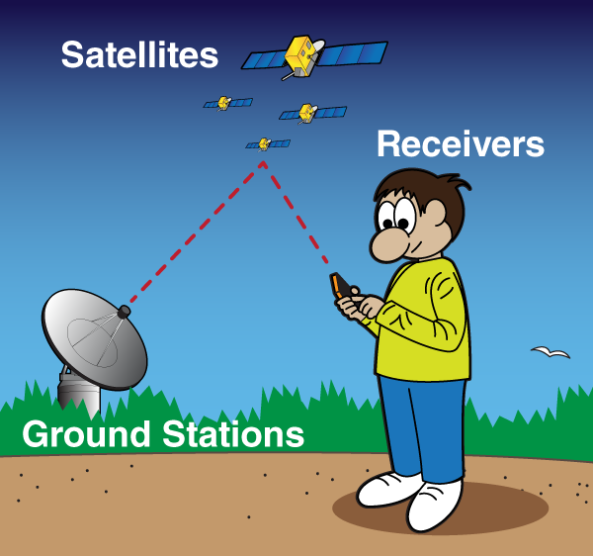
A global positioning system (GPS) is a networked information system.
Click image to view about how GPS works.
Source video: https://youtu.be/RSA3feQ9gKk Image source: spaceplace.nasa.gov/gps/en/

Slide 33
Explain how global positioning system (GPS) are a networked information system.
6
Image source: spaceplace.nasa.gov/gps/en/
Notes:
Teacher note: This is intended as an activity for formative assessment purposes. This could be done as a small group, paired or individual activity. It can be verbal, recorded as a video or audio file or written in the portfolio booklet.

Slide 34
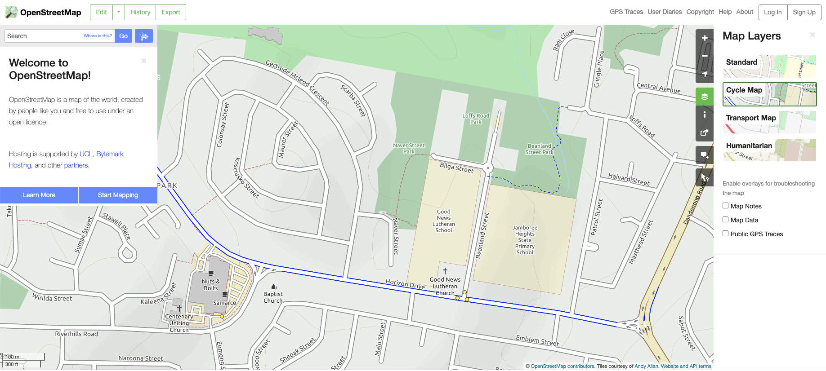
Let’s look at geographic information systems.
Image source: www.openstreetmap.org

Slide 35
Geographic information systems
You might have used an online map before such as Maps, Google Maps, OpenStreetMap or Google Earth.
These are all examples of geographic information systems.
A geographic information system is sometimes called GIS.
Image source: www.openstreetmap.org

Slide 36


What information does a GIS give us?
street names
north pointer
green spaces
cycle trails
public transport in the area
scale (distance calculations)
important places, for example, schools, churches, emergency services, shops
Image source: www.openstreetmap.org

Slide 37
Compare two online map systems for your local area.
7
What features do they have that are:
similar?
different?
sustainable?
What might online maps be able to do in the future?
What features of online maps are not available on traditional paper maps?
Image source: www.openstreetmap.org
Notes:
Teacher note: This is intended as an activity for formative assessment purposes. This could be done as a whole group, small group, paired or individual activity. Give students two different online systems to compare, for example Google Maps and OpenStreetMap.
Answers might include: They both have a north pointer. Both have satellite view. One gives cycle maps and the other doesn’t. One has population data and the other doesn’t. The answers aren’t important. This is time for students to become familiar with the overlays and options available for information searches. When considering sustainability, discuss the social sustainability and how paper maps go out of date and how online maps are updated frequently, often in response to real-time data; for example, traffic jams are indicated on live maps due to the number of mobile phones detected within a small radius. Discuss the economic sustainability of online maps vs printed maps and the energy it takes to produce them. Discuss the environmental sustainability and the resources needed to produce them. Is an online map more environmentally sustainable? Why or why not?

Slide 38
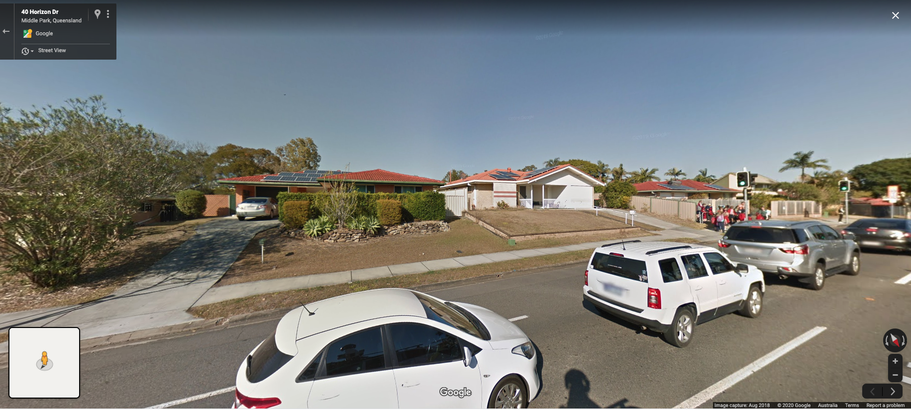
Why are number plates blurred in street view on online maps?
Source: https://www.google.com/maps
Notes:
Teacher note: This is an ‘impacts’ question (a key concept in the Digital Technologies curriculum). This is intended as a whole class discussion. Ask students what would happen if there was a case whereby someone was trying to protect their identity and their personal information was given out in an online map. For example, a famous pop star could have been photographed outside their house. What could happen? A family might have escaped from a war-torn country where their safety was compromised, and their personal information is made open to the world. Please have age-appropriate discussions with students and monitor for discomfort or emotional triggers (e.g. a child in protective custody).

Slide 39

What are some more reasons for personal information to be kept private in networked information systems?
8
Image source: https://pixabay.com/illustrations/password-app-application-business-2781614/
Notes:
Teacher note: This is intended as an activity for formative assessment purposes. This could be done as a whole group, small group, paired or individual activity. Students might give answers like money being taken from bank accounts, plagiarism, identity theft. Keep discussions age appropriate and check for emotional triggers. Privacy includes password protection and blurring of faces and identifying features in images and videos.

Slide 40
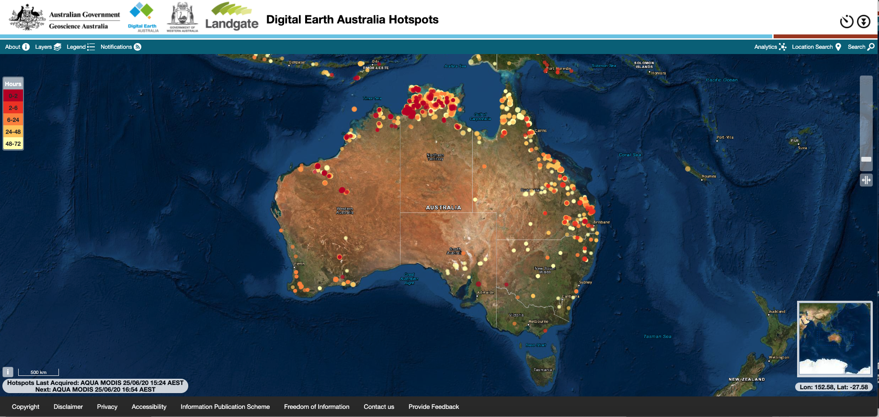
Other GIS – hotspots
9
Discuss how this GIS could be useful.
Source: https://hotspots.dea.ga.gov.au/acres/sentinel/index.shtml
Notes:
Teacher note: This is intended as an activity for formative assessment purposes. This could be done as a whole group or small group activity. This website shows data on recent and active bushfires. Students might give answers like keeping an eye on local natural disasters such as bushfires to alert people about whether they should travel or not. Keep discussions age appropriate and check for emotional triggers.

Slide 41
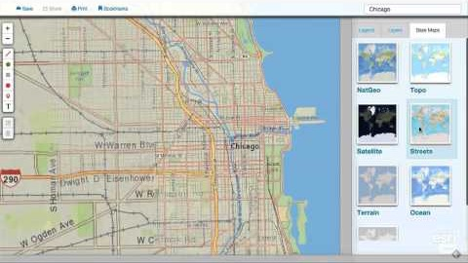
Other GIS – National Geographic MapMaker Interactive
10
Discuss how this GIS could be useful.
Video tutorial – getting started (1 min)
Source: https://youtu.be/gLgV_y-Yhxo
Interactive map:
https://mapmaker.nationalgeographic.org/
Notes:
Teacher note: This is intended as an activity for whole class formative assessment purposes. The purpose is to gauge if students understand how GIS works and could be useful. Discussions around the power of online maps versus traditional paper maps might be appropriate here, although it is covered a little later in the slideshow.

Slide 42
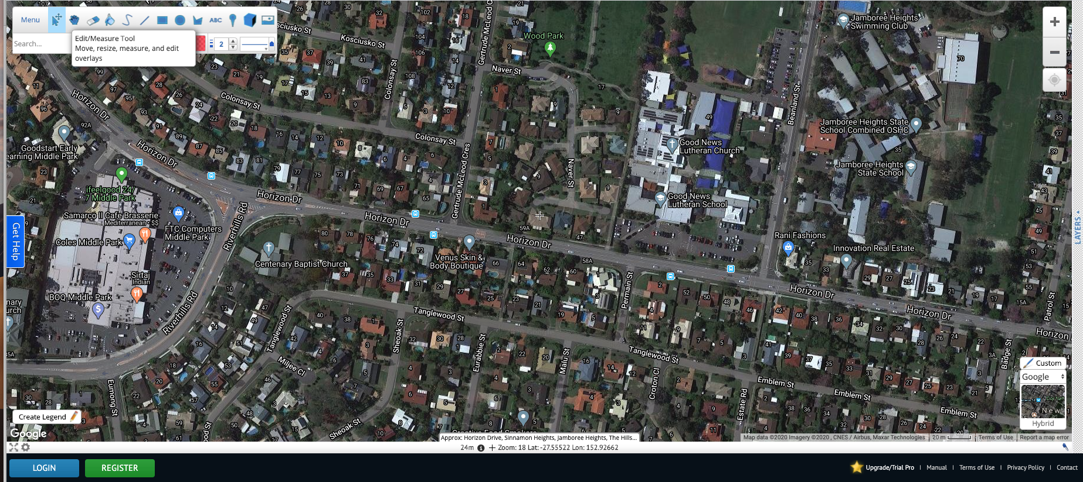
Other GIS – Scribble Maps
11
Go to scribblemaps.com and enter your school address.
Source: https://www.scribblemaps.com/
Notes:
Teacher note: This is intended as an activity for formative assessment purposes. This could be done as a small group, paired or individual activity.
Considerations:
This is an opportunity to discuss common features of satellite maps, including labels and view/zoom tools especially if these are new concepts for your students.
Excluding areas that are out of bounds. Using only satellite view it might also be difficult to tell buildings (indoor space) apart from COLAs and covered walkways (outdoor shade space). It is important that students are able to identify various items on the map in order to build a common understanding of what is represented.
Since we are asking students to think about shaded areas in the following activities, it might be useful to discuss the fact that the satellite map they are viewing is only a snapshot of the time of day this image was captured. As with all outdoor areas, the amount of shade will change according to the time of day (among other things). Even the full area of a COLA may not ever be 'in the shade’.
Depending upon the task the teachers designs and links to other learning areas, it may be useful to discuss the fact that not all areas that give shade block UV rays fully. This will depend on the material, e.g. shade cloth vs steel.

Slide 43

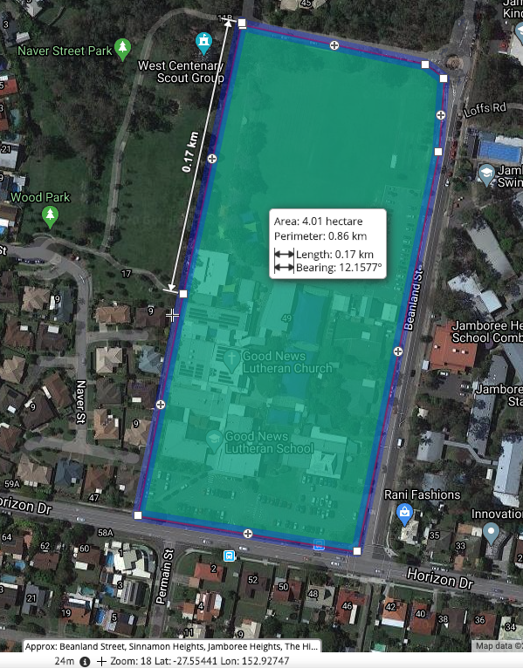
Scribble Maps activity
12
Use the polygon tool to draw a polygon around the perimeter of your school.
Use the measuring tool and hover over the polygon.
What data does it show?
How could this be useful?
Image source: httpscribblemaps.com/
Notes:
Teacher note: This is intended as an activity for formative assessment purposes. This could be done as a small group, paired or individual activity.
Scribble Maps video tutorial (5min 39sec) https://www.youtube.com/watch?v=pkDwyXCL9bk

Slide 44
Scribble Maps activity
13
Use Scribble Maps to look at your school in Satellite view.
Use the polygon tool to draw a series of polygons around the buildings of your school.
Calculate the total area of the buildings.
Use the polygon tool to draw a series of polygons around the outdoor shade spaces in your school (include shade trees).
Calculate the total area of outdoor shade spaces.
What do you notice?
Image source: httpscribblemaps.com/
Notes:
Teacher note: This is intended as an activity for formative assessment purposes. This could be done as a small group, paired or individual activity.
Considerations:
For question number 4, students will use the Scribble Maps map to calculate the total area of outdoor shaded spaces they are able to identify. As with all outdoor areas, the amount of shade will change according to the time of day (among other things). Even the full area of a COLA may not ever be 'in the shade’.
Scribble Maps video tutorial (5min 39sec) https://www.youtube.com/watch?v=pkDwyXCL9bk

Slide 45

Scribble Maps activity
14
How could you use Scribble Maps to help your local community?
Image source: https://pixabay.com/illustrations/together-earth-human-board-school-2450095/
Notes:
Teacher note: This is intended as an activity for whole class formative assessment purposes. Answers could include: to see where we could plant more trees, to see where it would be good to set up sporting or off-leash dog exercise areas, to see where we could run the cross-country trail, to plan where to build a nature reserve or extra buildings.

Slide 46
Group task – gather data
15
Part A
How could we promote healthy physical activity at break time?
How do we ensure we stay sun-safe during our physical activity?
How can we make use of a geographic information system to estimate how much usable* shade is in our school? (*What shaded areas can be used for exercise activities?)
Notes:
Teacher note: This is intended as an activity for whole class formative assessment purposes. It could also be done as a think-pair-share activity. The ultimate goal of this activity is for students to conclude that physical activities will need to be done safely (e.g. not include running on concrete) and should be designed to keep students as active as possible in limited spaces.
Considerations: Teachers may want to discuss what it means to be safe in the sun. What are the steps we need to take to reduce our exposure to UV rays whilst playing outdoors?

Slide 47
Group task – Design a digital system
Part B
How can an awareness of the shaded areas of our school be combined with a digital system to create activities that promote fun and fitness?
What could be invented to make people want to exercise in shaded areas at lunchtimes?
Each group must design one digital system to promote physical activity in the shade at lunchtimes.
Once your group design is complete, submit it to your teacher for approval.
Notes:
Teacher note: This is intended as an activity for to form part of the summative assessment task. It is intended to be completed in small groups. Designs would be dependent on resources available at your school. There is no compulsion for students to build the digital solution; however, it would be motivating for students to see their designs developed into working solutions.
Some examples of designs students could design inlcude:
micro:bit – egg-and-spoon race (tutorial https://makecode.microbit.org/examples/egg-and-spoon)
micro:bit – bouncy ball count (example tutorial for this step counter could be modified to be worn on the wrist https://makecode.microbit.org/projects/step-counter)
Spheros – Hot Potato (tutorial available at https://edu.sphero.com/cwists/preview/149x)
Scratch with camera input – catch virtual things using sensing blocks (example tutorial videos https://www.youtube.com/watch?v=23xstN6hgKI and https://www.youtube.com/watch?v=8vHEqVdWn08)
Dash robot – follow the leader (see https://www.makewonder.com/play/ideas/19/ ) and (tutorial video https://www.youtube.com/watch?v=X1qQGry9_iw)
Makey Makey – dance mat (example tutorial https://www.instructables.com/id/Makey-Makey-Dance-Revolution/)
Makey Makey data collection – score (example tutorial https://makeymakey.com/blogs/how-to-instructions/makey-your-own-exit-ticket-or-data-tracker)
Makey Makey – mini putt putt with timer (example video https://www.youtube.com/watch?v=uU9YeoIKkYA)
Lego EV3 with people as elements in obstacle course (example tutorial https://education.lego.com/en-us/lessons/mindstorms-ev3/object-detection#connect)

Slide 48
Group task – Manage your project
Part C
Create a portfolio as you plan to solve the problem.
Include screen shots, images and files in your portfolio.
Gather data about which shaded spots exist in the school and which ones are the most popular.
Make suggestions about how we could increase the shaded areas in our school and where these could be placed.
Explain how your design will be sustainable and meet needs.
Notes:
Teacher note: This is intended as an activity to form part of the summative assessment task. It is intended to be completed in small groups to ensure they manage their project according to agreed timeframes.
As an extension, students could create interactive posters with Makey Makeys or micro:bits by getting other students to ‘check-in’ to the shaded areas to gather data about popularity. Alternatively, students could sit and keep tallies of visitors or use cameras to monitor the shaded areas.

Slide 49
Group task – Build your digital system
Part C
(Optional)
Continue to enter evidence in your portfolio as you solve the problem.
Include screen shots, images, photos, filenames and videos in your portfolio.
Present your digital system to the class once you’ve built it. Explain how your digital system meets needs and is sustainable.
Notes:
Teacher note: This is intended as an activity to form part of the summative assessment task. It is intended to be completed in small groups to ensure they manage their project according to agreed timeframes.
As an extension, students could create interactive posters with Makey Makeys or micro:bits by getting other students to ‘check-in’ to the shaded areas to gather data about popularity. Alternatively, students could sit and keep tallies of visitors or use cameras to monitor the shady areas.

Slide 50
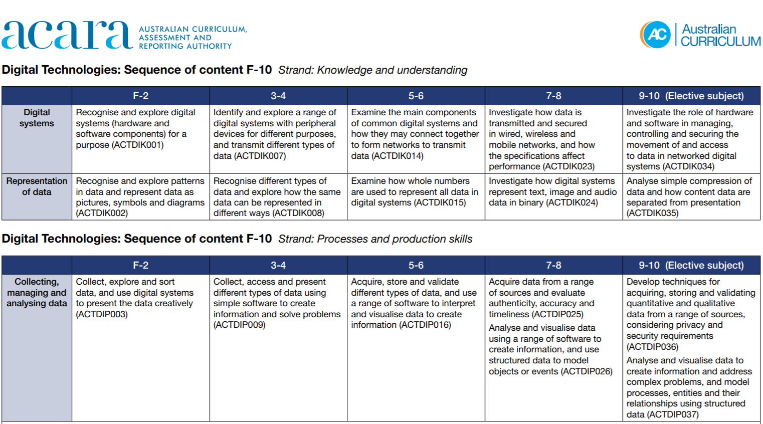
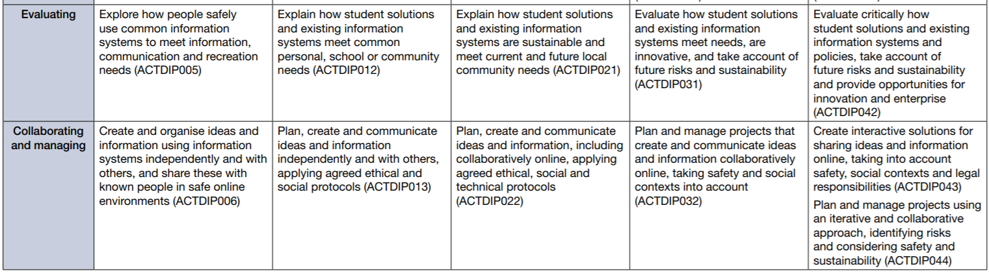
Source: www.docs.acara.edu.au/resources/Digital_Technologies_-_Sequence_of_content.pdf

Slide 51
Achievement standard
By the end of Year 6, students explain the fundamentals of digital system components (hardware, software and networks) and how digital systems are connected to form networks. They explain how digital systems use whole numbers as a basis for representing a variety of data types.
Students define problems in terms of data and functional requirements and design solutions by developing algorithms to address the problems. They incorporate decision-making, repetition and user interface design into their designs and implement their digital solutions, including a visual program.
They explain how information systems and their solutions meet needs and consider sustainability. Students manage the creation and communication of ideas and information in collaborative digital projected using validated data and agreed protocols.
Content descriptions
Examine the main components of common digital systems and how they may connect together to form networks to transmit data (ACTDIK014)
Acquire, store and validate different types of data, and use a range of software to interpret and visualise data to create information (ACTDIP016)
Explain how student solutions and existing information systems are sustainable and
meet current and future local community needs (ACTDIP021)
Plan, create and communicate ideas and information, including collaboratively online, applying agreed ethical, social and technical protocols (ACTDIP022)
Notes:
Teacher note: Content descriptions and relevant sections of the achievement standard for this activity are highlighted. If assessing the digital solution, include the following section of the achievement standard: Students define problems in terms of data and functional requirements and design solutions by developing algorithms to address the problems. They incorporate decision-making, repetition and user interface design into their designs and implement their digital solutions, including a visual program. They explain how information systems and their solutions meet needs and consider sustainability. Students manage the creation and communication of ideas and information in collaborative digital projected using validated data and agreed protocols.

